Slide 1
Using Automated Machine Learning to Predict NBA Player replacement
Final Project – Group 1 – NBA Player Replacement

Slide 2



TEAM MEMBERS:
Juan Ulloa | ulloajuan@hotmail.com
Adam Burstyn | adam.burstyn@gmail.com
Ignacio Domaica | idomaica@gmail.com

Slide 3
https://share.streamlit.io/aburstyn9068/nba_player_comparison/main/app.py

Slide 4
AGENDA
PROJECT DESCRIPTION
PROJECT REQUIREMENTS
SOURCES
ETL
EXTRACTION
TRANSFORMATION
LOAD
USER INTERFACE & VISUALIZATIONS
CONCLUSIONS

Slide 5

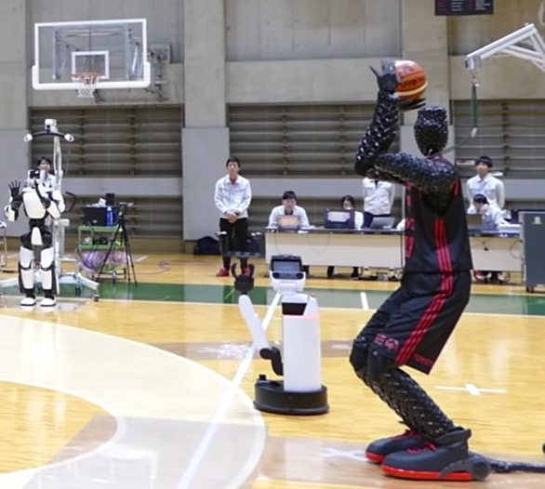
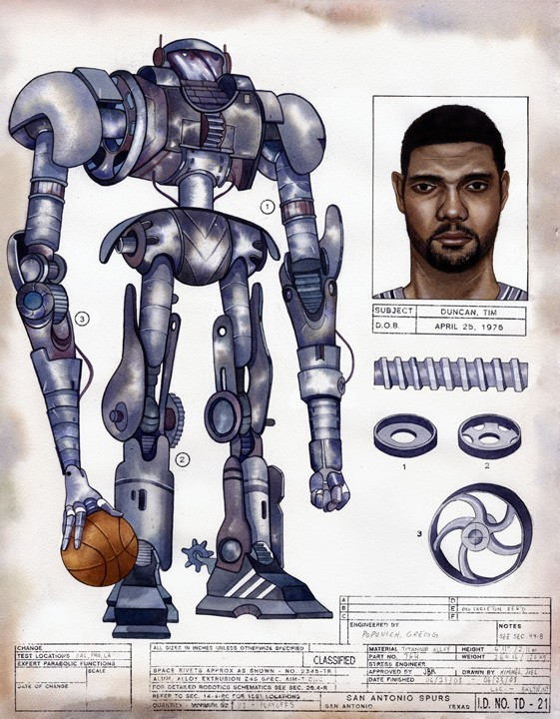

Project title
NBA player robot replacer
Using Automated Machine Learning to Predict NBA Player replacement

Slide 6
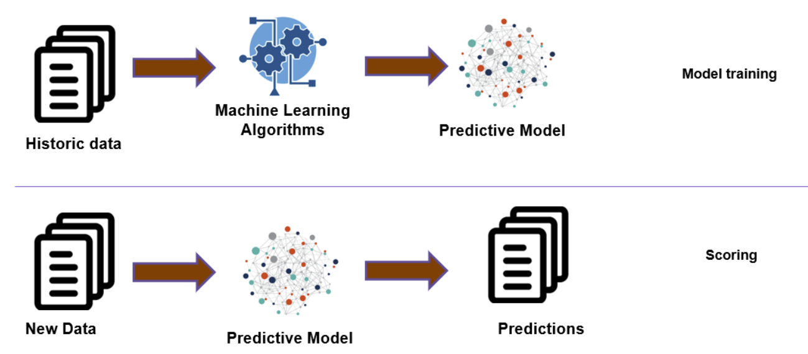
Description & Scope
The idea would be to determine which player is best suited to fill a certain position on any NBA team based on existing players and-or including draftees or not.

Slide 7

Main TECHNOLOGIES used to deploy this project
‘Python’
’Plotly’
’Streamlit’
‘Matplotlib’. Cross-platform for data visualization and graphical plotting library for Python
‘Sklearn’
Linear Regression.
Random forest regression. Trying to predict college players NBA rookie year stats
Euclidean distance

Slide 8
AGENDA
PROJECT DESCRIPTION
PROJECT REQUIREMENTS
SOURCES
ETL
EXTRACTION
TRANSFORMATION
LOAD
USER INTERFACE & VISUALIZATIONS
CONCLUSIONS

Slide 9

SOURCES
DATA.- Collected from:
Kaggle.
NCAA Stats. https://www.kaggle.com/robikscube/ncaa-data-20152019-sportsreference
NBA stats
https://www.basketball-reference.com/leagues/NBA_2021.html
https://hoopshype.com/salaries/players/
MAIN CHARACTERISTICS
Pretty straight forward process
Abundance of data & statistics
Standardized data

Slide 10
AGENDA
PROJECT DESCRIPTION
PROJECT REQUIREMENTS
SOURCES
ETL
EXTRACTION
TRANSFORMATION
LOAD
USER INTERFACE & VISUALIZATIONS
CONCLUSIONS

Slide 11
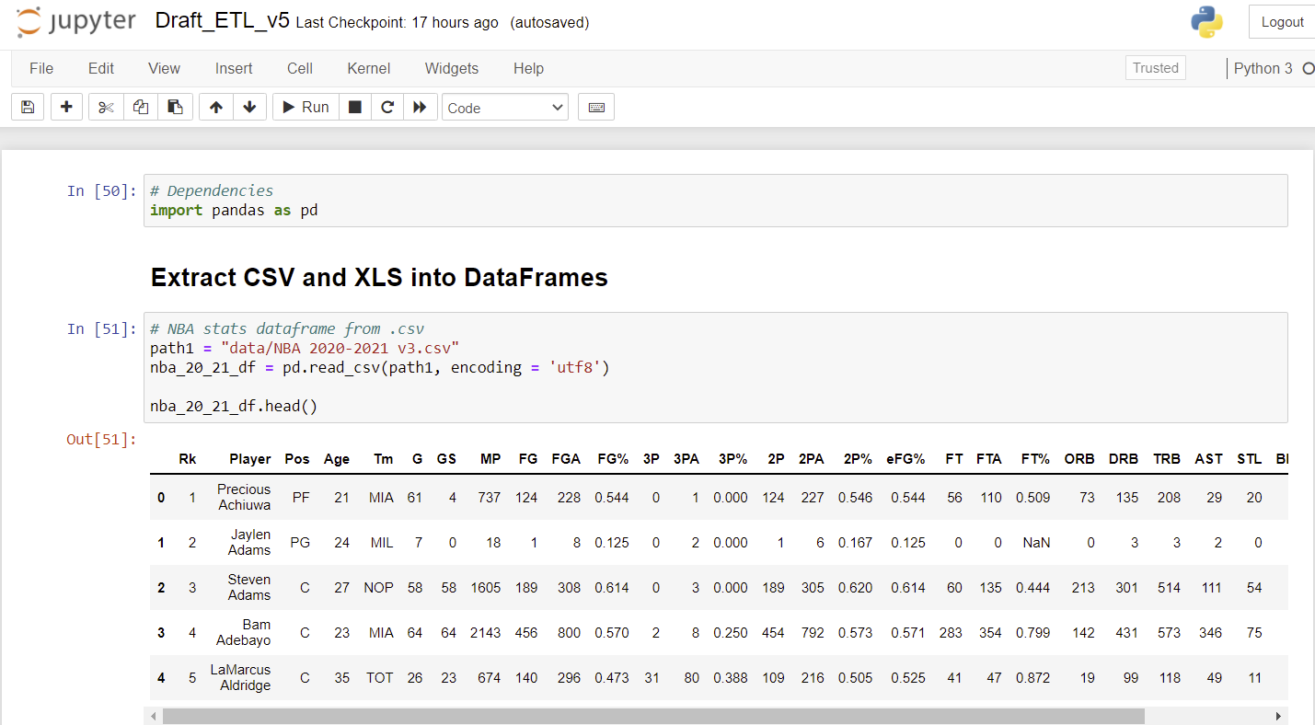
EXTRACTION
Dependencies

Slide 12
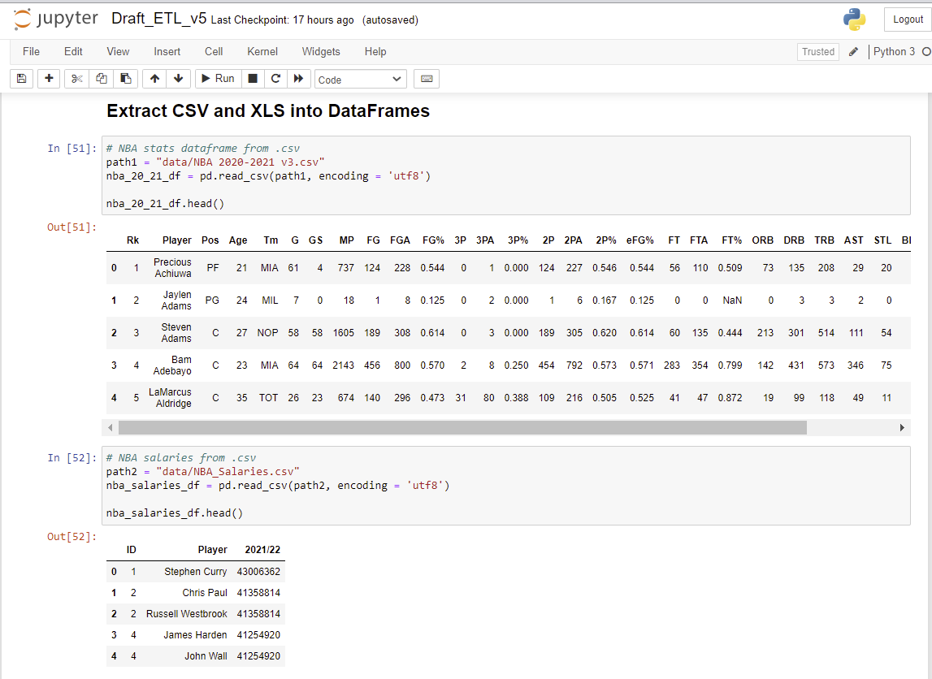
EXTRACTION. Reading .csv for stats & Salaries

Slide 13
AGENDA
PROJECT DESCRIPTION
PROJECT REQUIREMENTS
SOURCES
ETL
EXTRACTION
TRANSFORMATION
LOAD
USER INTERFACE & VISUALIZATIONS
CONCLUSIONS

Slide 14
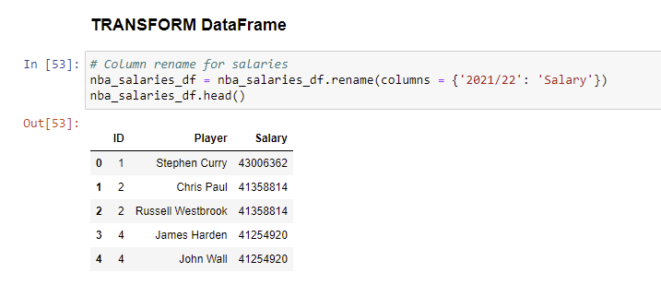
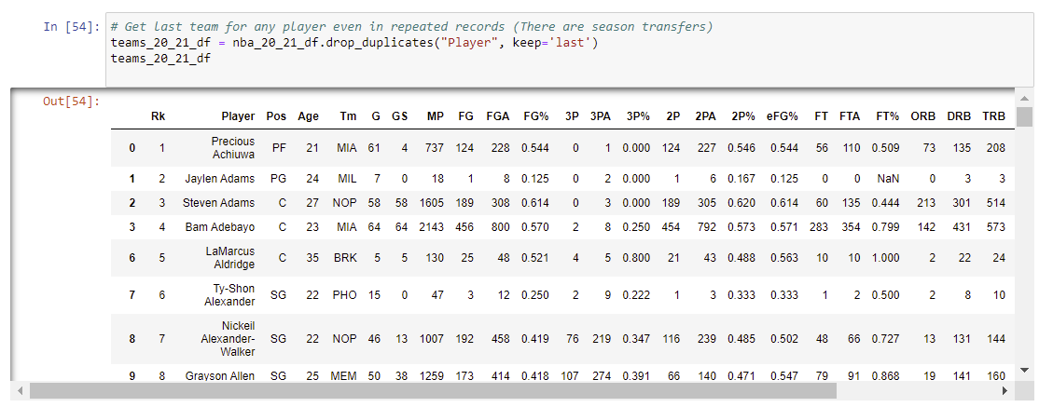
TRANSFORMATION #1. To produce statistical cleaned data
Rename
Get last team of a player dropping duplicates

Slide 15
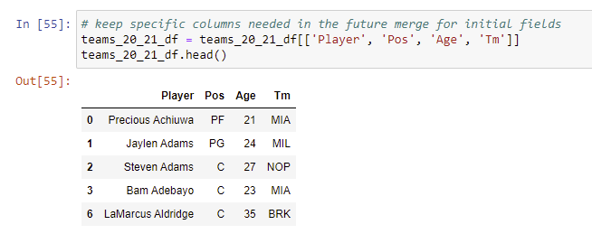
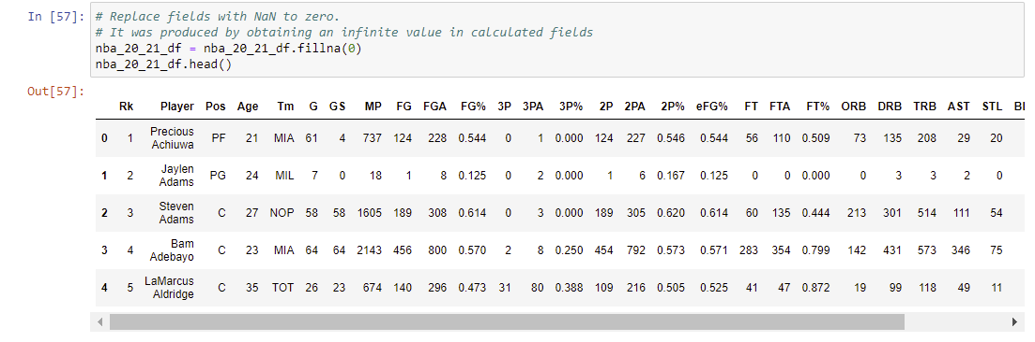
TRANSFORMATION #1. To produce statistical cleaned data
Get dataframe with initial columns needed for specific player
Begin transformation of rest of data

Slide 16
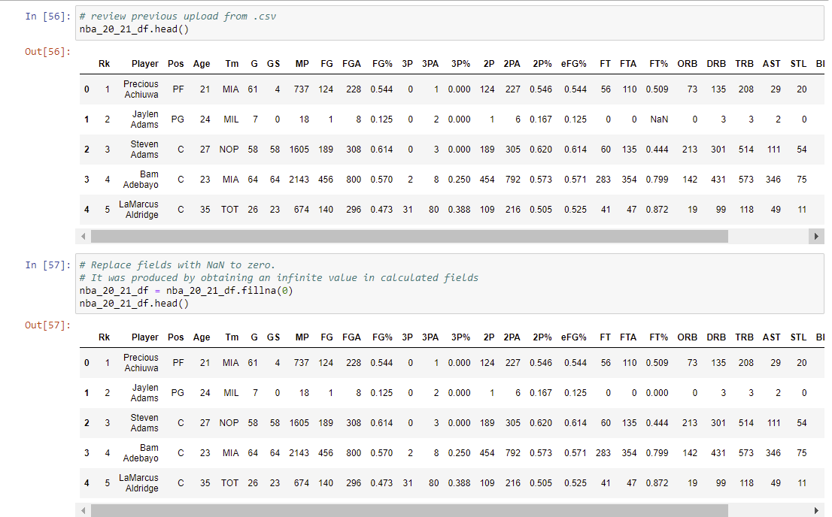
TRANSFORMATION #1. To produce statistical cleaned data
Begin transformation for rest of data

Slide 17
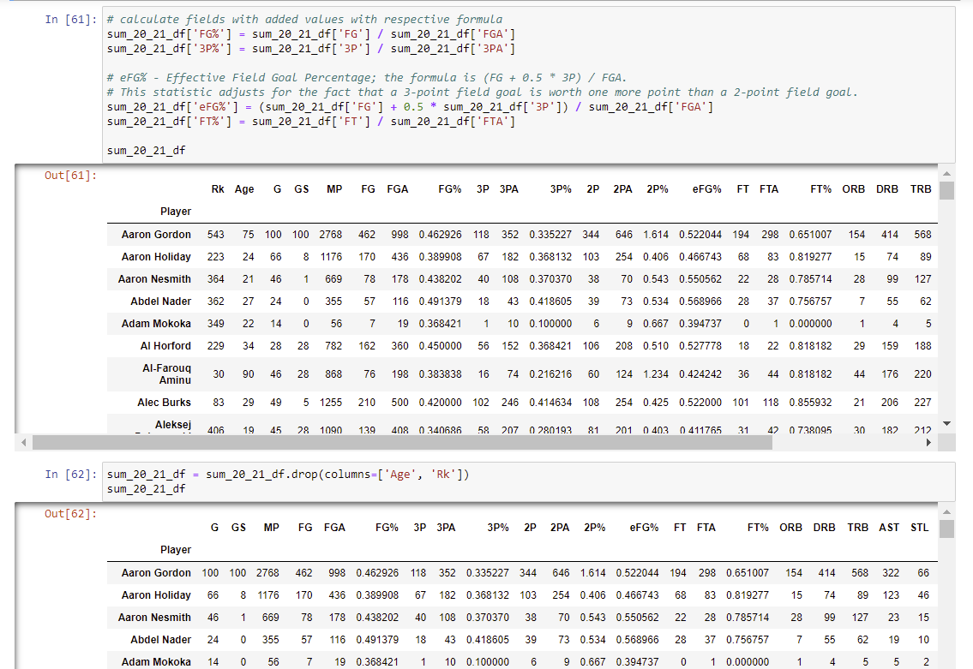
TRANSFORMATION #1. To produce statistical cleaned data
Recalculate calculated values (f.ex. %)
Drop unnecessary columns

Slide 18
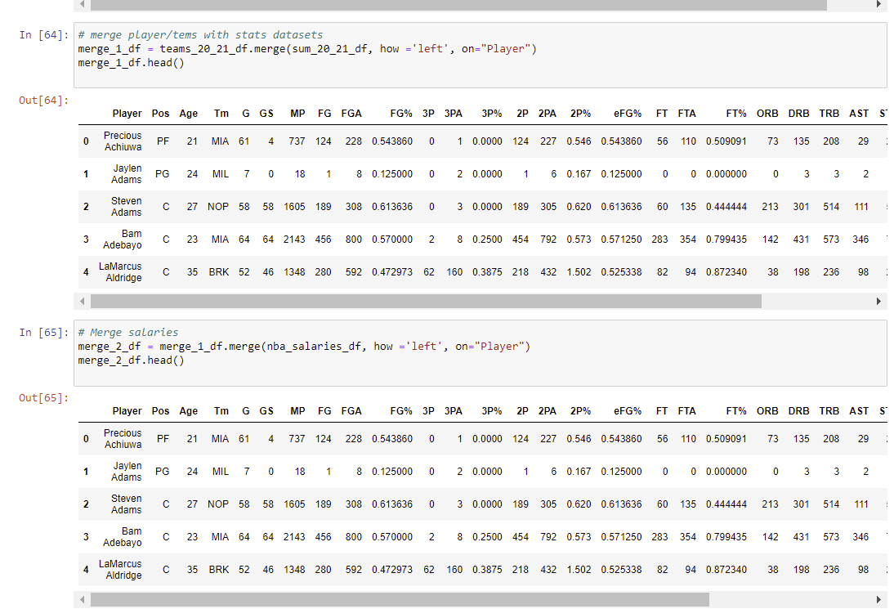
TRANSFORMATION #1. To produce statistical cleaned data
Merge 3 datasets consecutively

Slide 19
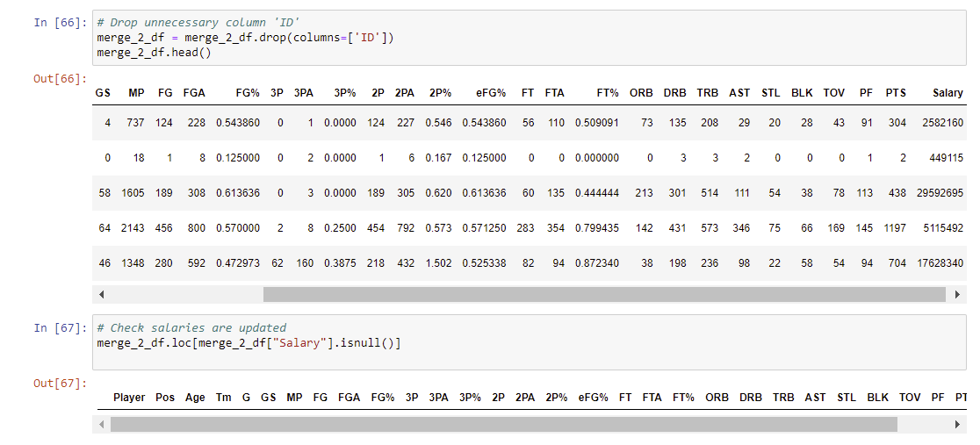
TRANSFORMATION #1. To produce statistical cleaned data
Final drop
Check salaries are updated

Slide 20
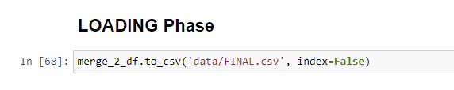

LOAD #1. To produce statistical cleaned data

Slide 21
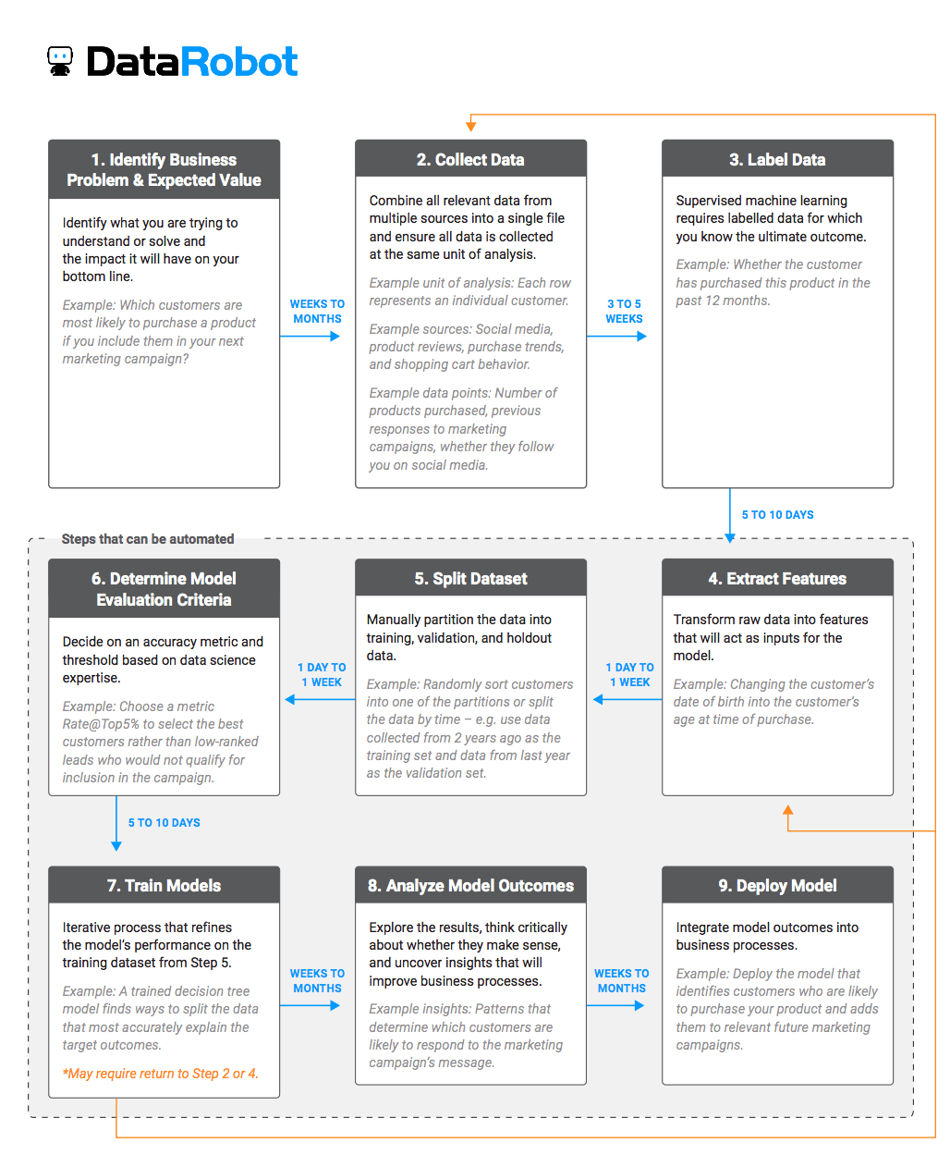
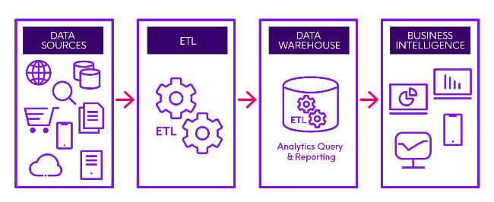

ETL #2
After producing a LINEAR REGRESSION and analyzing it, we were able to verify that it is not possible (based on this analysis) to obtain a good prediction of the rookie behavior/stats/performance of a player in NBA based on the data of the last year of college (NCAA stats).
Therefore we have executed a 2nd ETL cycle in order to produce a new analysis based on RANDOM FOREST REGRESSION
To do so, we need to start a 2nd ETL process:
ETL – Extract new data NCAA (college player data), NBA Rookie data
ETL – Transform. Split datasets
ETL – Load save .csv
Finally train models and analyze model outcomes

Slide 22
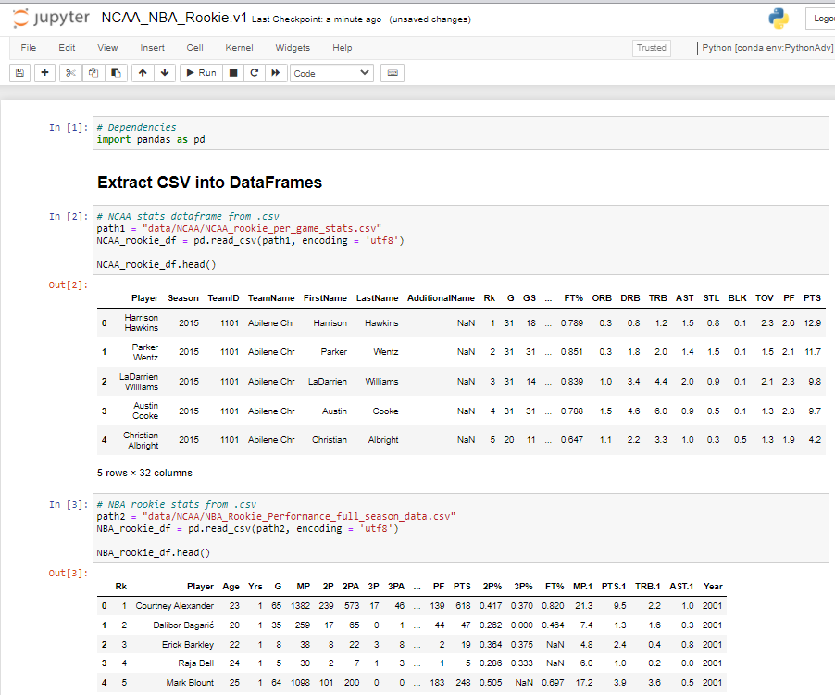
ETL #2 - EXTRACTION. Reading .csv for stats

Slide 23
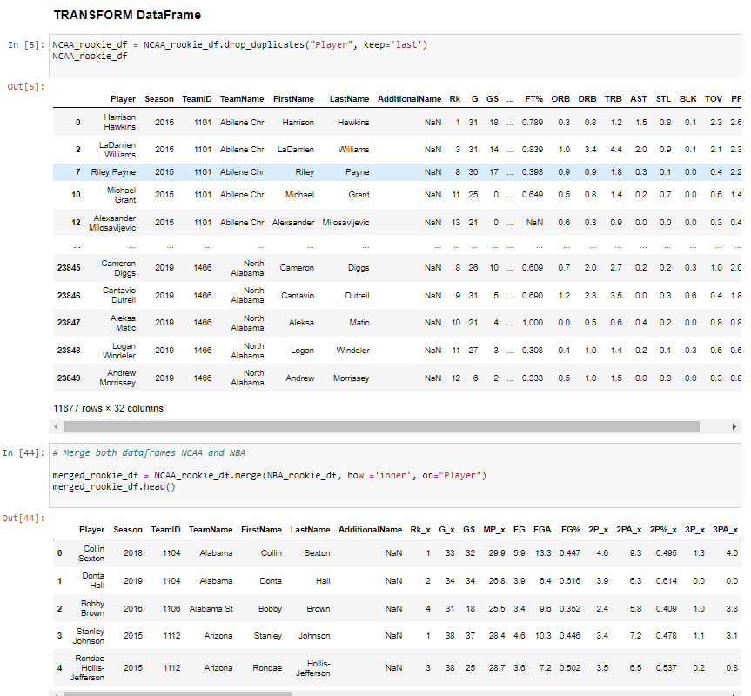
ETL #2 – TRANSFORMATION. To do machine learning models. Random Forest Regression
Get last team of a player dropping duplicates
Merge data by dataframes

Slide 24
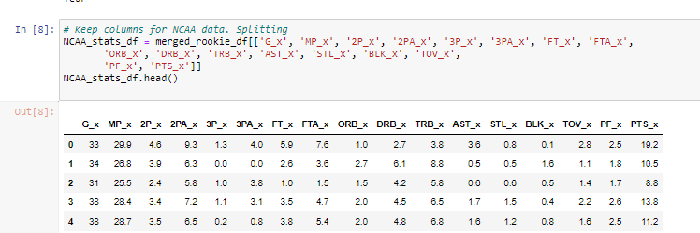
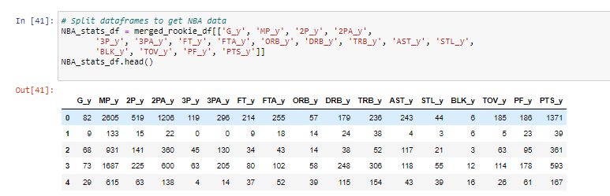
ETL #2 – TRANSFORMATION. To do machine learning models. Random Forest Regression
Split dataframe for NCAA stats by keeping specific columns
Same for NBA stats

Slide 25
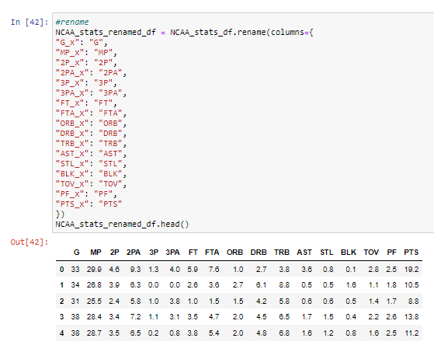
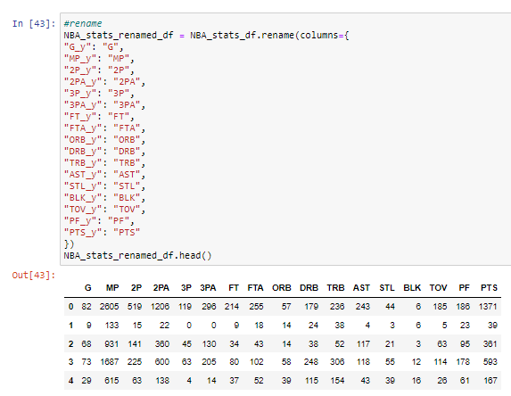
ETL #2 – TRANSFORMATION. To do machine learning models. Random Forest Regression
Rename for NCAA stats
Same for NBA stats

Slide 26
ETL #2 – LOADING PHASE. To do machine learning models. Random Forest Regression

Slide 27
AGENDA
PROJECT DESCRIPTION
PROJECT REQUIREMENTS
SOURCES
ETL
EXTRACTION
TRANSFORMATION
LOAD
USER INTERFACE & VISUALIZATIONS
CONCLUSIONS

Slide 28
AGENDA
PROJECT DESCRIPTION
PROJECT REQUIREMENTS
SOURCES
ETL
EXTRACTION
TRANSFORMATION
LOAD
USER INTERFACE & VISUALIZATIONS
CONCLUSIONS

Slide 29
AGENDA
PROJECT DESCRIPTION
PROJECT REQUIREMENTS
SOURCES
ETL
EXTRACTION
TRANSFORMATION
LOAD
USER INTERFACE & VISUALIZATIONS
CONCLUSIONS

Slide 30
CONCLUSIONS
The purpose of this exercise was to find a machine learning model that would help us to get the best one to replace a certain player, taking into account his game position and previous performance.
We used three options: First, finding the closest ones; second, determining salary levels; and third, looking for the best options with the NCAA players.
We were able to identify the closest players within the NBA and we tried to correlate the two leagues in order to determine which NBA player could be replaced by one from the NCCA, within the analysis we found that there is no correlation between any key features. which leaves this claim without strong foundations.
On the contrary, we found that the distance allowed us to identify the players closest to the player we wanted to replace, this allowed us to measure the Key Features between players, identify which of them is closer and further away, see their performance and be able to see their salary levels .In conclusion, we can say that this allows us to identify the Key Performance indicators of the player we want to replace and to know which of the players are closer to him could replace him and how much he would cost.

Slide 31



Slide 32
BACK UP
32

Slide 33
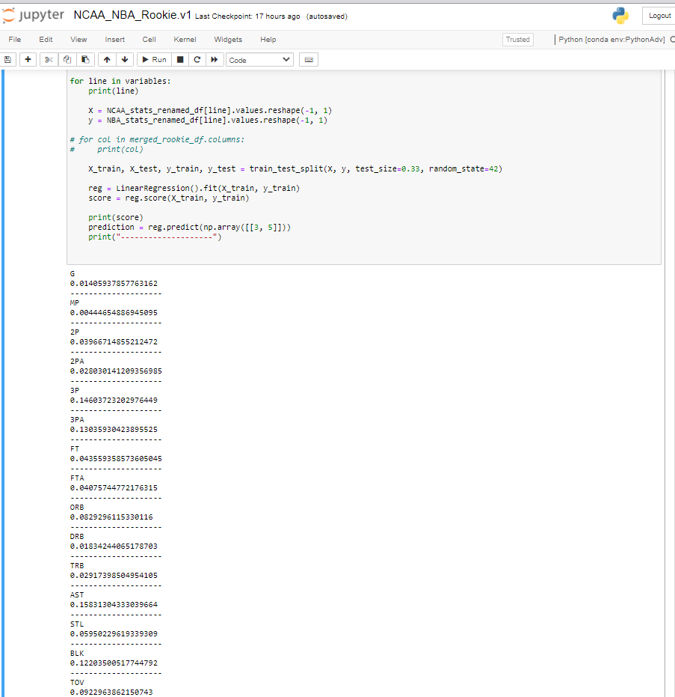
Linear Regression Results

Slide 34
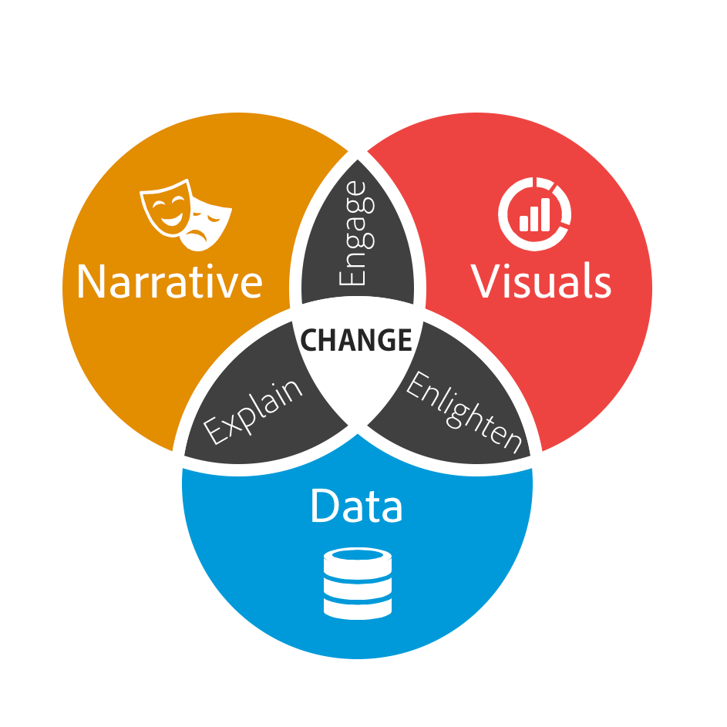

Slide 36
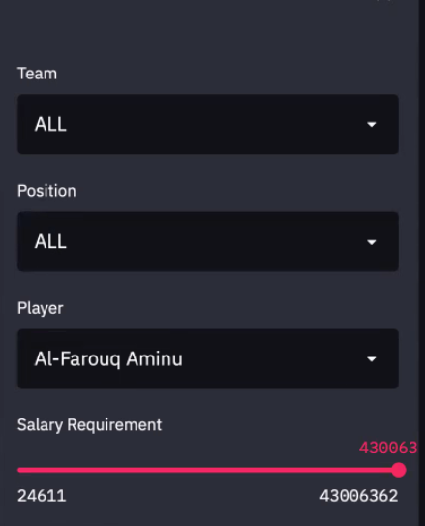

Slide 37
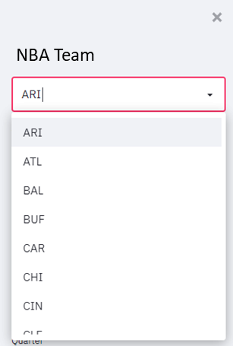
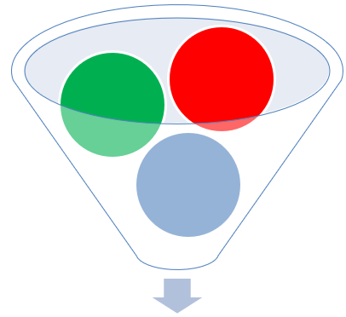
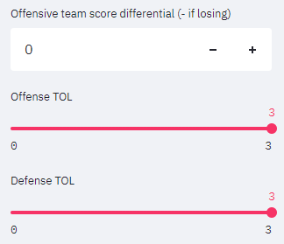
Design / Steps
STEP 1.- Select specific team
Select specific player
STEP 2.- Selected player will have specific performance reflected in stats.
Specific performance data can be loaded as defaults to make corrections using additional tools, like sliders, filters, etc?
DATA.- Will be collected from:
Kaggle
NBA stats
https://www.basketball-reference.com/leagues/NBA_2021.html
https://hoopshype.com/salaries/players/

Slide 38
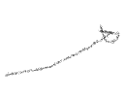
Design / Steps (2)
CLOSEST PLAYER PERFORMANCE COMPARISON
XXXXX
Most similar
Including every stat and similar performance
Explain salary size dots
Color red or team colors
Team colors dictionary if possible
Glossary
SALARY
Specific players have contracts and salaries. Do we want to filter players also with salary data to respect salary caps?

Slide 39
Design / Steps (3)
STEP 3.- Apply models and machine learning to make proper forecasting / predictions
Will make up to 5 recommendations:
Closest player
Closest player including salary

Slide 40
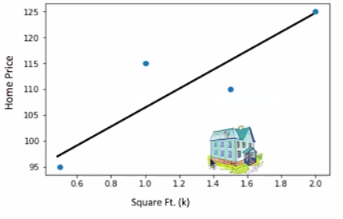
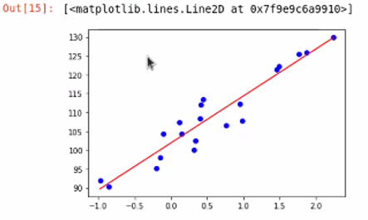
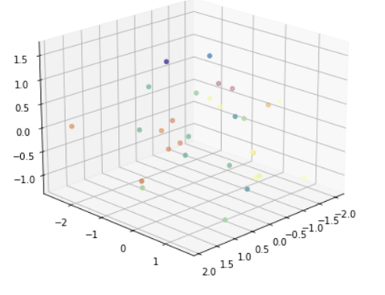
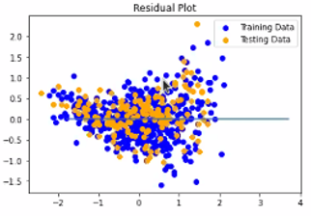

MODELS
Clustering
Euclidean distance

Slide 41
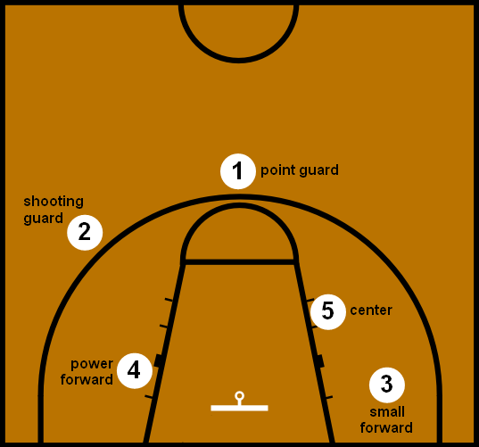
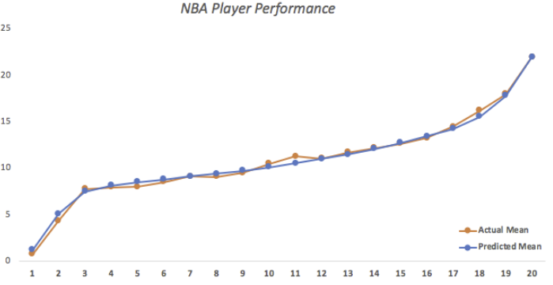
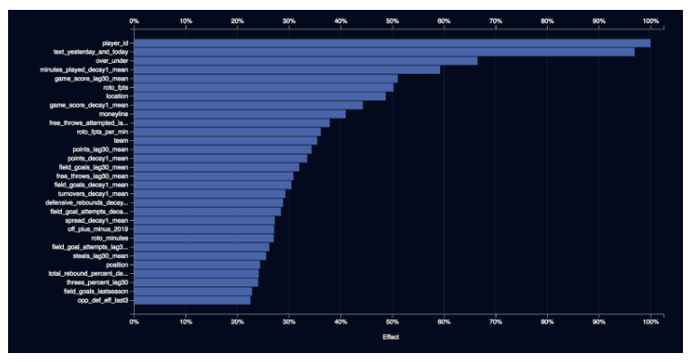
VISUALIZATIONS
To be determined:
Pyvis, network graph
Maxplotlib

